Slide 1


Slide 2
Arkansas State University
Arkansas State University is a public institution of higher education.
Employees of Arkansas State University are public employees.
The Arkansas Freedom of Information Act applies to Arkansas State University.

Slide 3
Title IX

Slide 4
Arkansas State University's Policy
Arkansas State University is committed to providing an educational and work environment for its students, faculty, and staff that is free from sexual discrimination including sexual harassment, sexual assault, and sexual violence. No form of sexual discrimination will be tolerated.

Slide 5
Arkansas State University's Policy
Employees with supervisory responsibilities, including deans, vice chancellors, department chairs, faculty, student conduct personnel, human resources, athletics administrators and coaches, and university police personnel must report incidents of sexual discrimination either observed by them or reported to them to the Title IX Coordinator who will conduct an immediate, thorough, and objective investigation of all claims.

Slide 6
Title IX Coordinator
The person on campus charged with ensuring compliance with all aspects of Title IX. Ensures that all investigations are immediate, thorough and objective.

Slide 7
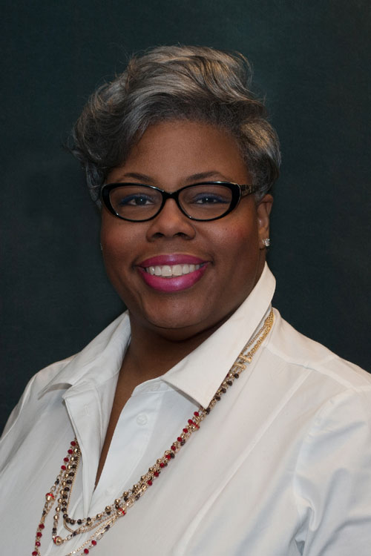
Arkansas State University Title IX Coordinator
Perdeta Bush, Title IX Coordinator
Phone: 870-972-2015
Fax: (870) 972-3337
Email: pbush@astate.edu

Slide 8
Students with Disabilities

Slide 9
Students with Disabilities
Growing student segment on college campuses.
Students may need accommodations.
How are those accommodations communicated to faculty?
Where should you go for help and assistance if you have questions?

Slide 10
Students with Disabilities
Communicating with Parents of students with disabilities (Be Mindful of FERPA)
If you receive a communication from the Office of Access and Accommodations that relates to a student accommodation, please be sure that you are mindful of that accommodation. If you have questions, then please contact the Office of Access and Accommodations.
Highly recommend communication between you and the Office of Access and Accommodations to Ensure Needs are Met and Appropriately Addressed.
  dservices@astate.edu Phone: 870-972-3964

Slide 11
Child Maltreatment

Slide 12
Quick Review:
All employees, and all volunteers participating in ASU conducted programs on ASU owned or occupied property, will immediately report known or suspected child maltreatment to the State of Arkansas Child Abuse Hotline and the police department having jurisdiction over that campus.
Any employee, or any volunteer participating in an ASU conducted program on ASU owned or operated property, must immediately report known or suspected child maltreatment by contacting both the Child Abuse Hotline and the police department having jurisdiction over that campus. Each campus will post the telephone numbers on their home web page under the heading Child Maltreatment Reporting.
Full Policy at:
https://www.asusystem.edu/about/policies/

Slide 13
University Police Department ext. 2093
Arkansas Child Abuse Hotline
1-800-482-5964

Slide 14
Appropriate Use of Information and Technology Resources
Policy Highlights:
  Users are entitled to access only those IT Resources that are consistent with their authorization. Access is limited to members of the University Community, faculty, staff, students, and other specifically authorized individuals.
  Use in violation of law. Examples of such uses are: promoting a pyramid scheme, accessing or distributing illegal material, copyright infringements, and making terroristic threats, engaging in political activities.
  Use that impedes, interferes with, impairs, or otherwise causes harm to the activities of others. Users must not deny, attempt to deny, or interfere with service to other users in any way, including by “resource hogging,” misusing mailing lists, propagating “chain letters” or virus hoaxes, “spamming” (spreading email or postings widely and without good purpose), or flooding an individual, group, or system with numerous or large email messages. Other behavior that may cause excessive network traffic or computing load is also prohibited.

Slide 15
ASU SYSTEM POLICIES & SYSTEM HANDBOOK
ASU System Policies:
  https://www.asusystem.edu/about/policies/
ASU System Handbook:
    https://www.asusystem.edu/about/handbooks/

Slide 16
FACULTY HANDBOOK
Faculty Handbook:
    https://www.astate.edu/a/academic-affairs-and-research/files/official/Faculty-Handbook.pdf

Slide 17
Family Educational Rights and Privacy Act
Comprehensive Protection for Student Privacy
Registrar’s Office
Importance of Being Cautious with Student Information
Institutions of Higher Education Risk Receipt of Federal Funding for Violations.

Slide 18
University Contracts
PURCHASING AUTHORITY
  The Procurement Official is the sole purchasing authority of the University. Purchases not authorized by this authority are not legal obligations of the University. Any individual making a purchase without proper authority first being given is assuming a personal obligation to the vendor for whom he/she may be held personally liable. The department, and those within the department, are not authorized to sign contracts, agreements, terms and conditions or other required paperwork from a vendor. These must be sent to Procurement Services. The only exception is Sodexo event forms for your department.
Excerpt from Procurement Training for End Users 2019; Modified July 2019
See the Procurement Website for full details on Purchasing
https://www.astate.edu/a/procurement/index.dot

Slide 19
Purchasing Supplies and Materials
Each department has authorized end users to process purchases.
Utilize your end users to avoid purchasing issues. This is the best way to avoid trademark violations, purchase against state contracts and comply with all university and state procurement policies.
When in doubt, ask.
Procurement Services
Phone: 870-972-2028
Email: procurement@astate.edu

